Slide 1
Implement of Many-Core System Midterm Project
109061641 林庭寬

Slide 2
Outline
Sharpen Filter
The Architecture of Sharpen Filter
Sharpen Filter in HLS(with data reuse and loop unrolling and pipeline)
Compare time and area with accelerator and without accelerator
result

Slide 3
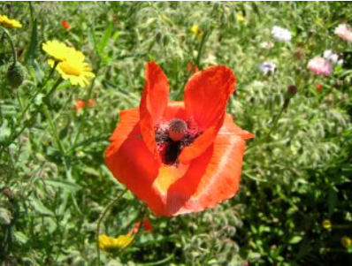
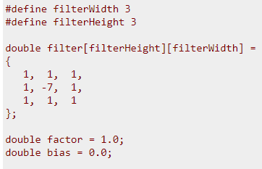
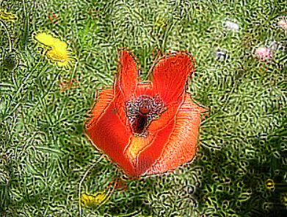
Sharpen Filter

Slide 4
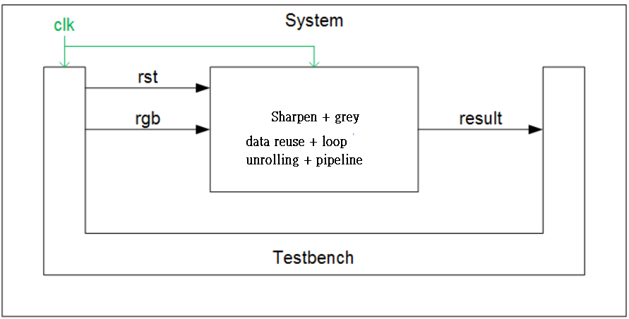
The Architecture of Sharpen Filter

Slide 5
Sharpen Filter in HLS
Filter kernel
……
0
1
2
Picture data
……
……
2
0
1
……
……
1
2
0

Slide 6
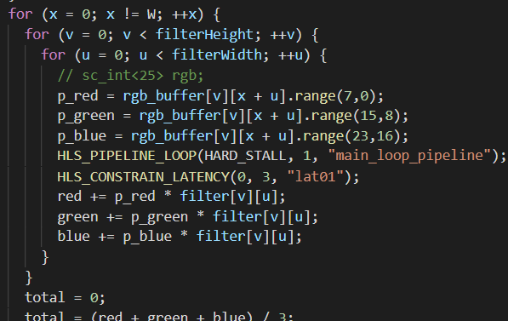

Slide 7
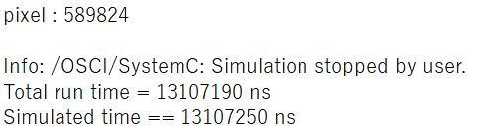
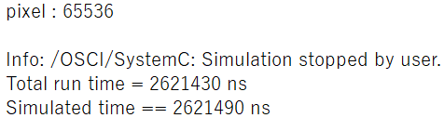
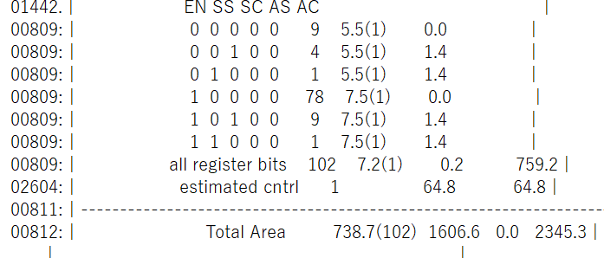
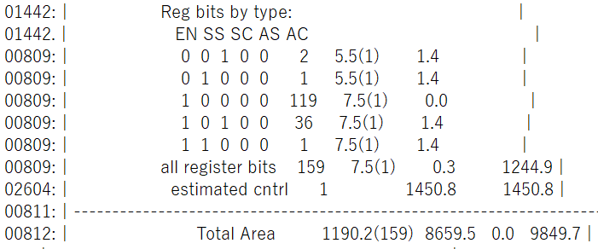
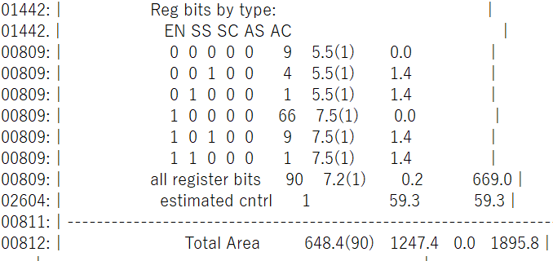
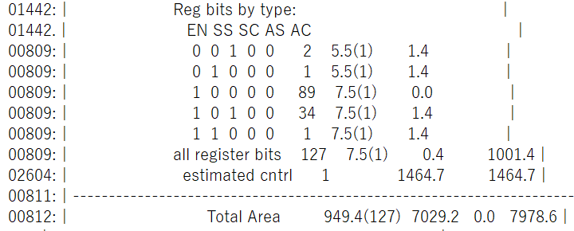
BASIC different of area(1/2)___ Sharpen Filter

Slide 8
BASIC different of area(2/2)___ Sharpen Filter
 | No accelerator | With accelerator | Speed up / area rate
pixel | 589824 | 65536 | 9
Simulation time | 13107250 | 2621490 | 5
BASIC area | 2345.3 | 9849.7 | 4.2
DPA area | 1895.8 | 7978.6 | 4.2

Slide 9
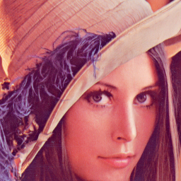
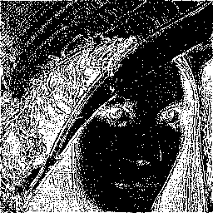
result

Slide 10
Thank you

